Slide 1
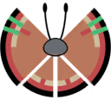
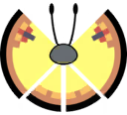
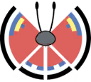
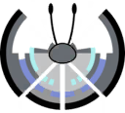
Archipelago
Continental
Caribbean
South Africa
Argentina
Central Europe
( Germany, Poland, Denmark )
Central Asia
India
Modern
Monsoon
Southeastern US
Southeast Asia
Notes:
Bottom Text Left

Slide 2



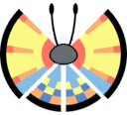
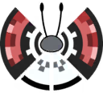

Elegant
Fancy
Garden
Japan
No Location Found
United Kingdom
Ireland
New Zealand
Ocean
Poke Ball
Polar
Hawaii
Galapagos Islands
Madagascar
No Location Found
Alaska
Eastern Canada
Western Candada
Northeastern US
Southern Argentina
Chile
Northern Europe
( Norway, Sweden, Finland )
Notes:
Bottom Text Right

Slide 3

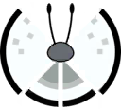

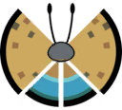
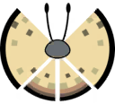
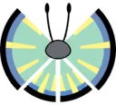
High Plains
Icy Snow
Jungle
Western US
Eastern Europe
Greenland
Northern Canada
Northern Europe
( Norway, Finland, Sweden )
Colombia
Northern South America
Central Africa
Indonesia
River
Sandstorm
Savanna
North Africa
Egypt
South Africa
South Australia
Middle East
Brazil
North Australia

Slide 4


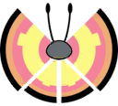


Marine
Meadow
Chile
Greece
Eastern Europe
( Hungary, Romania, Bulgaria )
Spain
Central Europe
( France, Italy )
Sun
Tundra
Mexico
Madagascar
Iceland
Southern Norway
Sweden
Northern Japan

